Slide 1
ANATOMY OF THE LACRIMAL APPARATUS

Slide 2
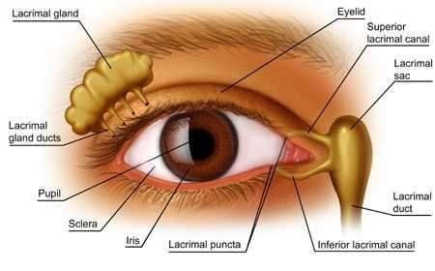
1.Lacrimal gland 2.Lacrimal ducts 3.Conjunctival sac
4.Lacrimal puncta 5.Lacrimal canaliculi 6.Lacrimal sac
7.Naso lacrimal duct

Slide 3
Embryology
Osteology
Secretory system
Excretory system

Slide 4
EMBRYOLOGY
DEVELOPMENT-LACRIMAL GLAND
surface ectoderm
Initially solid cords formed from supero lateral conjunctiva,but by 3months central cells vacuole and lumina appear
Full differentiation by 3-4 yrs postnatally
Composed of ectodermal glandular units and mesodermal myoepidermal cells and fibrous tissue.
Functions 6wks after birth.so no tears in new born when crying.

Slide 5
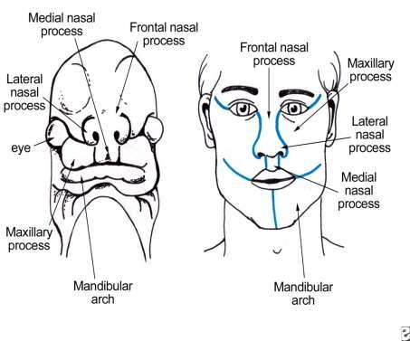
DEVELOPMENT- LACRIMAL SAC & NASO LACRIMAL
DUCT
At junction of maxillary process and lateral nasal process a mass of ectodermal cells submerge gets canalised to form lacrimal sac and naso lacrimal duct.
Non fusion of maxillary and lateral processes results in oblique facial cleft and in such cases NLD not formed.

Slide 6
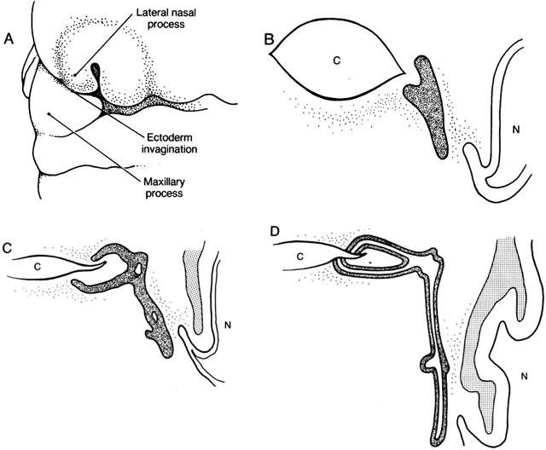
Lacrimal drainage system embryology.
At 5.5 weeks' gestation, an ectodermal invagination forms between the lateral nasal process and maxillary process, which becomes pinched off from the surface.
B. At 6 weeks' gestation, a solid cord of ectoderm is located between the primitive medial canthus and nose.
C. At 12 weeks' gestation, proliferation of the cord occurs laterally toward the eyelid and inferiorly toward the inferior turbinate. The isolated cavities shown appear at 3 to 4 months.
D. At 7 months, canalization is nearly complete.

Slide 7
OSTEOLOGY
The lacrimal sac fossa is a depression in the inferomedial orbital rim,
Maxillary and lacrimal bones.
Bordered by the anterior lacrimal crest (maxillary bone) & posterior lacrimal crest (lacrimal bone).
The fossa is approximately 16-mm high, 4- to 9- mm wide, and 2-mm deep.

Slide 8
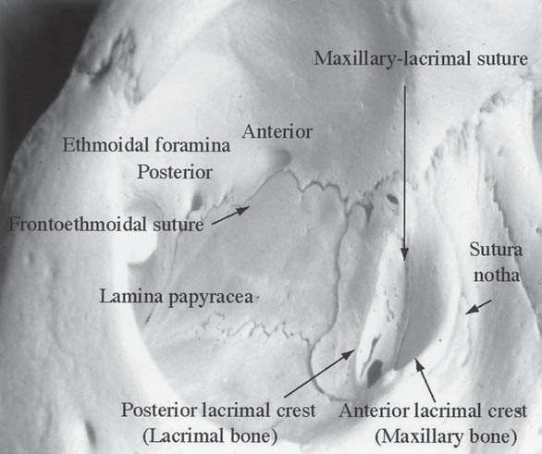

Slide 9
The nasolacrimal canal originates at base of lacrimal fossa.
Formed by the maxillary bone laterally and the lacrimal and inferior turbinate medially.
The width of superior opening is 4–6 mm.
The duct courses posteriorly and laterally in the bone for 12 mm to drain into the inferior meatus of the nasal cavity.

Slide 10
SECRETORY SYSTEM
It includes lacrimal gland & accessory glands
Lacrimal gland is above & anterolateral to globe.
Secretes tears into superior fornix.
Tears moisten & lubricates the cornea , conjunctiva.

Slide 11
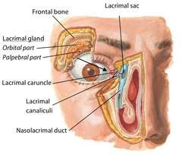
ANATOMY
Located in anterolateral part of the roof of orbit in fossa for lacrimal gland
Divided in to large superficial orbital part and small deep palpebral part which are continuous with each other around aponeurosis of LPS

Slide 12
LACRIMAL DUCTS
10-12 ducts
Ducts arising from the orbital part passes through palpebral part and opens in to superior fornix of conjunctiva
Additional ducts from palpebral part open directly in to conjunctiva
Removal or damage to palpebral part of the gland will stop secrections reaching the fornix
So biopsy of gland always done in orbital part of lobe

Slide 13
EXCRETORY SYSTEM

Slide 14
CONJUNCTIVAL SAC
Conjunctiva stretches from lid margin to limbus and encloses a potential space conjunctival sac which opens at palpebral fissure
Sac is closed only when lids are approximated

Slide 15
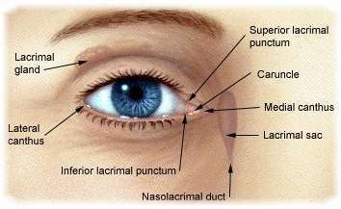
LACRIMAL PUNCTA
Two puncta situated in each lid margin at the junction of ciliary and lacrimal parts on elevtion called lacrimal papilla
Upper punctum 6mm and lower 6.5 mm from medium canthus
Surrounded by fibrous tissue which keeps them patent

Slide 16
LACRIMAL CANALICULI
2 in number,Joins puncta to lacrimal sac
Two parts vertical(2mm) and horizontal(8mm) at junction dilated to form ampulla
Pierce lacrimal fascia and unite to form common canaliculi opens in to lacrimal sinus of maier
At opening in to sac protected by valve of rosenmuller
Surrounded by fibres of pars lacrimalis of orbicularis oculi muscle
During blink canaliculi pulled medially,shortened and compressed by pars lacrimalis, also helps in dilatation of lacrimal sac

Slide 17
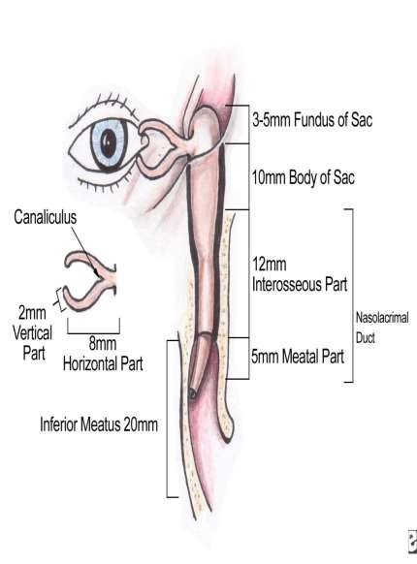
LACRIMAL SAC
Upper expanded portion of NLD
Lodged in lacrimal fossa(medial wall is lamina papyracea,formed by lacrimal bone and frontal process of maxilla)
Surrounded by lacrimal fascia which results from splitting of periorbita
Between sac and fascia are venous plexus
Part of sac above MPL is fundus.At junction of fundus and body diverticulum called

Slide 18
RELATIONS
Anteriorly to medial palpebral ligament
Posteriorly to posterior lacrimal crest and orbicularis oculi
Medially to middle meatus and ant ethmoidal sinus
Laterally to skin,fascia and orbicularis oculi(lacrimal part)
ANGULAR VEIN and ANGULAR ARETRY crosses
MPL about 8mm from the medial canthus.many times a tributary runs 3mm from medial canthus.so to avoid profuse bleeding during sac surgery, incison should be made within 3mm medial to medial canthus

Slide 19
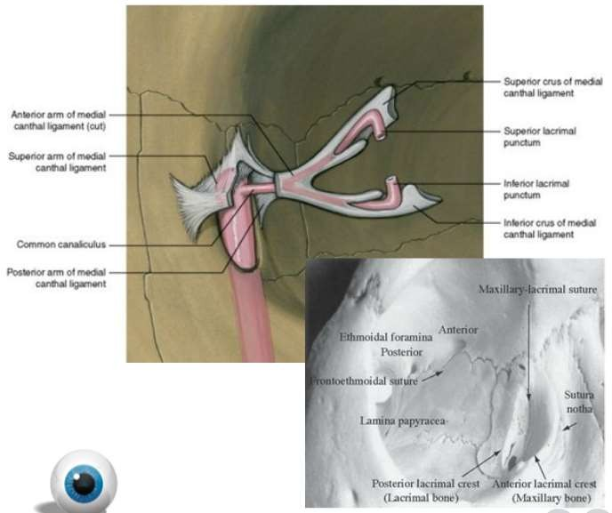

Slide 20
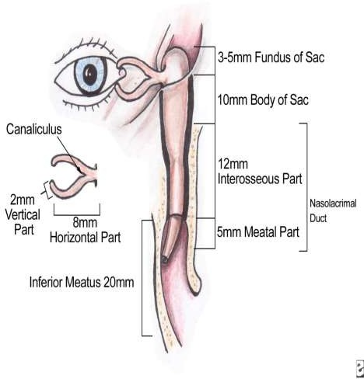
NASO LACRIMAL DUCT
Extends from lacrimal sac to inferior meatus of nose
18 mm in length and 3mm diameter
Upper end is the narrowest
Runs downward,backward and laterally
Lined by two layers of coloumnar epithelium
Has intraosseus and intra mural part

Slide 21
BLOOD SUPPLY
NERVE SUPPLY
Infra trochlear nerve
Anterior superior alveolar N.
ARTERIAL SUPPLY
Superior and inferior palpebral
A.
Angular A. Infraorbital A.
Nasal br. Of sphenopalatine A.
VENOUS DRIANAGE
Angular vein
Infraorbital vein Nasal vein
LYMPHATICS
Sub mandibular group Deep cervical group

Slide 22
ELIMINATION OF TEARS
Lacrimal fluid over the preocular surface→marginal tear strip→Lacus lacrimalis→inner canthus→ lacrimal passages → nasal cavity
Lacrimal pump mechanism:-
Fibres of the pretarsal & preseptal portion of the Orbicularis which arise from the lacrimal fascia & posterior lacrimal crest.

Slide 23
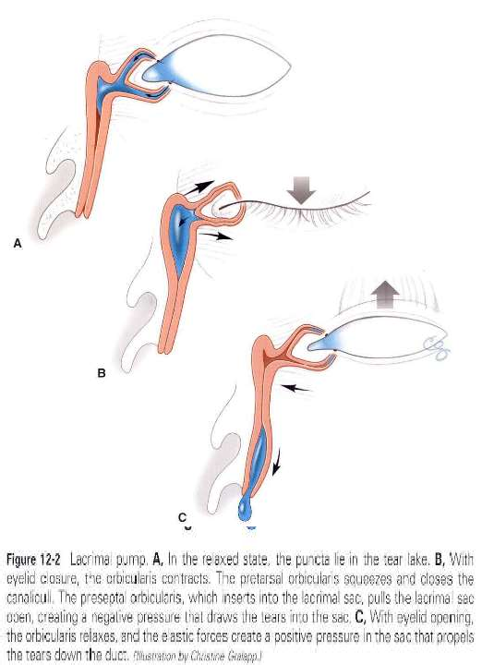

Slide 24
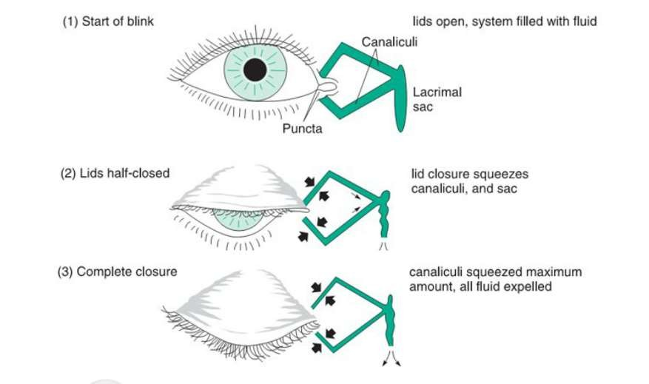

Slide 26
DRAINAGE OF LACRIMAL FLUID FROM NLD INTO NASAL CAVITY:
Gravity helps downward flow.
Air currents in nose induce negative pressure within NLD draw the fluid down the potential lumen of the duct into the nose.
Hasner’s valve present at lower end of NLD, remains open as long as the pressure within nose is less than the NLD, allows the tears to flow from NLD to nose

Slide 27
THANK YOU

